Slide 1
Determining the Chronological age of fossils
Guide NAME:
Dr.E.Anbalagan
Professor/Cse

Slide 2
Introduction
In the vast history, fossils are the silent witnesses to ever-unfolding the life on Earth .
Fossils offering glimpses into ancient ecosystems and the organisms that once roamed the planet.
This is essential for piecing together the puzzle of evolution and unraveling the timeline of life on earth.
The process of dating fossils encompasses various techniques, each tailored to different time scales and geological contexts.
Radiometric dating methods, such as carbon-14 dating and potassium-argon dating are methods to ascertain its age.
In this exploration of fossil dating methods, we delve into principles, techniques and significance of determining the chronological age of fossils.

Slide 3
Abstract
Determining the chronological age of fossils is essential for reconstructing the evolutionary history of life on Earth and understanding the processes that have shaped biodiversity over geological time scales
This abstract explores the diverse array of scientific methods and techniques employed in fossil dating, ranging from radiometric dating and stratigraphic correlation to paleomagnetic analysis and biostratigraphy.
Radiometric dating methods, such as carbon-14 dating and uranium-series dating, exploit the decay of radioactive isotopes within fossils to provide absolute age estimation.
while stratigraphic correlation and biostratigraphy establish relative age relationships based on the position and distribution of fossil assemble ages within sedimentary sequences

Slide 4
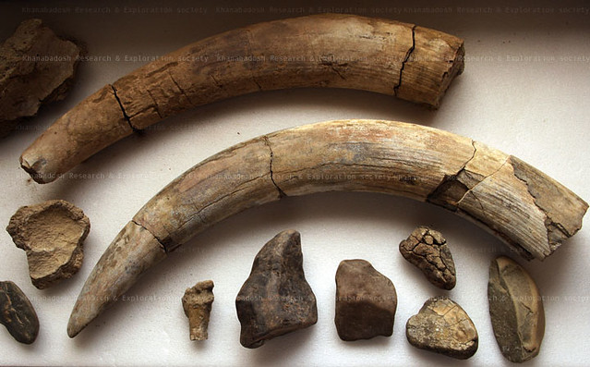
Problem Statement
The Existing methods are based upon carbon dating methods . This methods cannot give accurate age of fossils.
This methods can make impact on the fossils and leads to lose of carbons.
By using Radiometric dating method we can get accurate age of fossils.
This can leads to find when the life source are begin on the earth.
This Photo by Unknown Author is licensed under CC BY-SA-NC

Slide 5
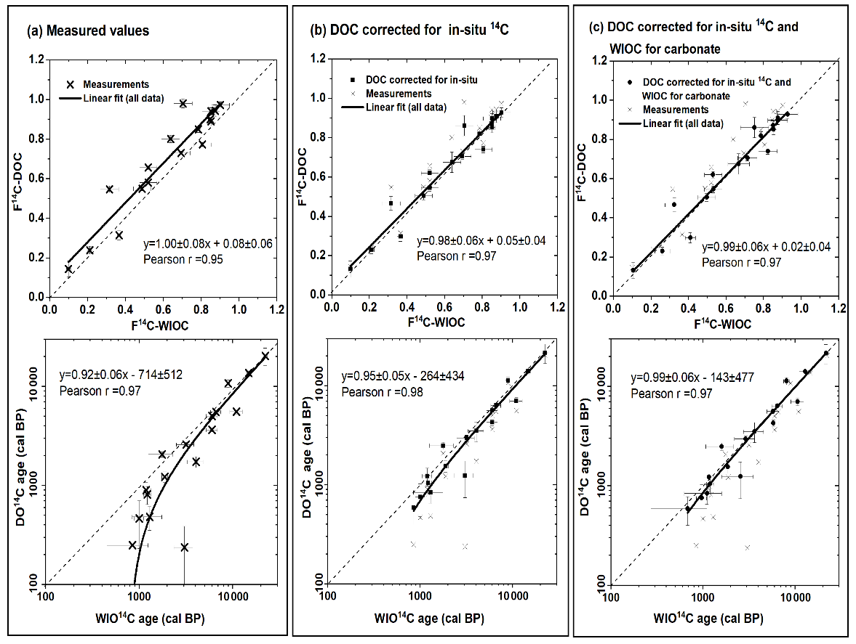
Proposed Objectives
Enhance the precision and accuracy of radiometric dating methods by refining calibration techniques and addressing sources of uncertainty, such as contamination and sample heterogeneity.
Investigate the application of emerging technologies, such as high-resolution imaging, micro sampling, and isotopic fingerprinting, to enhance the resolution and reliability of age determinations for individual fossils and sedimentary sequences.

Slide 6
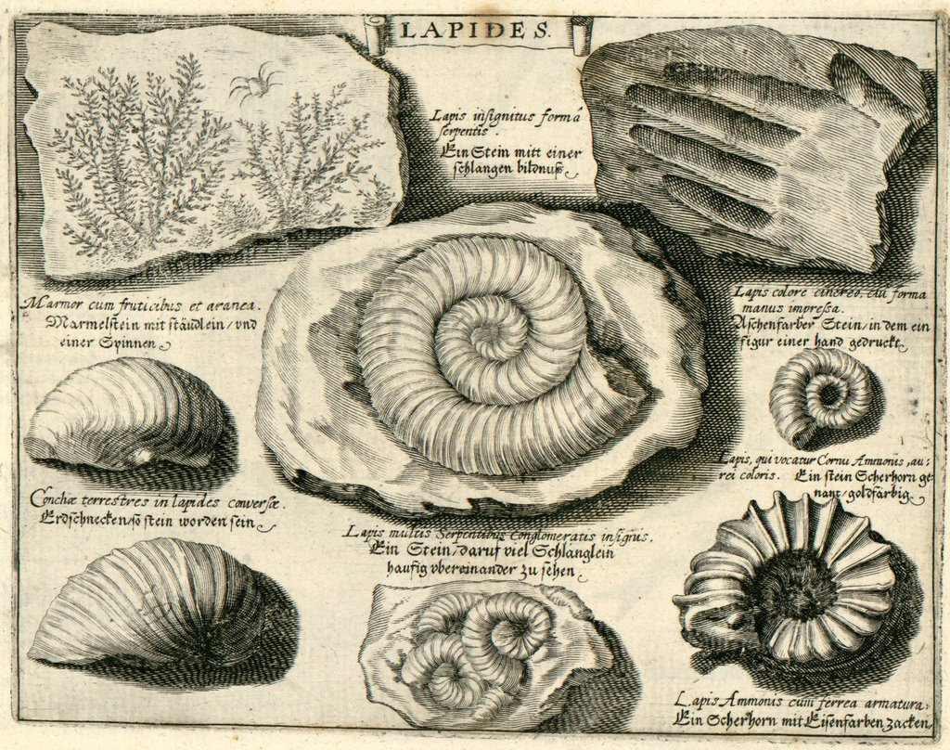
Novelty
Utilizing a combination of traditional radiometric dating methods with innovative proxy indicators, such as biomarkers, stable isotopes, and elemental composition, to establish robust age constraints and enhance the reliability of age determinations for fossils.
Implementing machine learning algorithms to analyze large datasets of fossil and geological information, allowing for more precise age predictions and the identification of previously unrecognized patterns or correlations in fossil chronology.
This Photo by Unknown Author is licensed under CC BY-SA

Slide 7
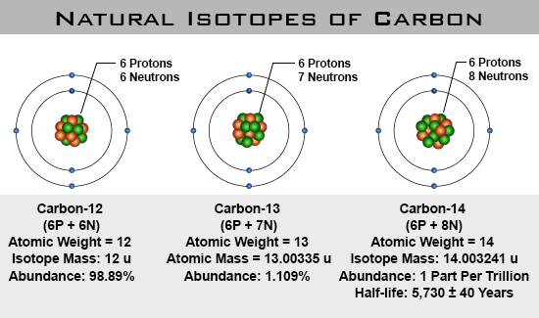
->Identify target fossil specimens from relevant geological formations or excavation sites. -> Conduct preliminary examination and documentation of the fossil specimens, including morphological descriptions and taxonomic identification. -> Select appropriate radiometric dating methods based on the age range, preservation state, and mineral composition of samples -> Apply techniques such as uranium-lead (U-Pb) dating, potassium-argon (K-Ar) dating, or argon-argon (Ar-Ar) dating to date minerals associated with the fossils -> Collect oriented core samples from fossil-bearing sediments to measure the direction and intensity of the ancient magnetic field -> Combine results from radiometric dating, stratigraphic correlation, and paleomagnetic analysis to generate comprehensive age models for the fossil-bearing deposits
DESign

Slide 8
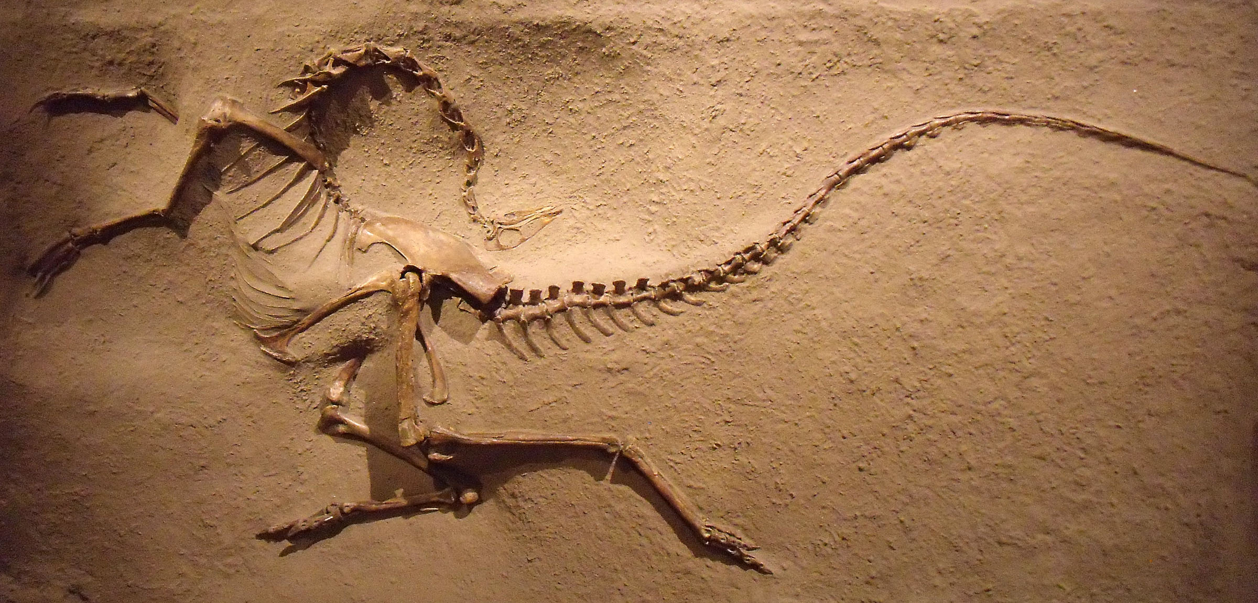
Implementation
Field researchers identify fossil-rich sedimentary formations and carefully collect representative samples using geological mapping techniques
Samples undergo initial preparation in the laboratory, including cleaning, cutting, and grinding to expose target minerals or organic material suitable for dating
Stratigraphic data collected from the field are integrated with radiometric age constraints to establish age-depth relationships within the sedimentary sequence

Slide 9
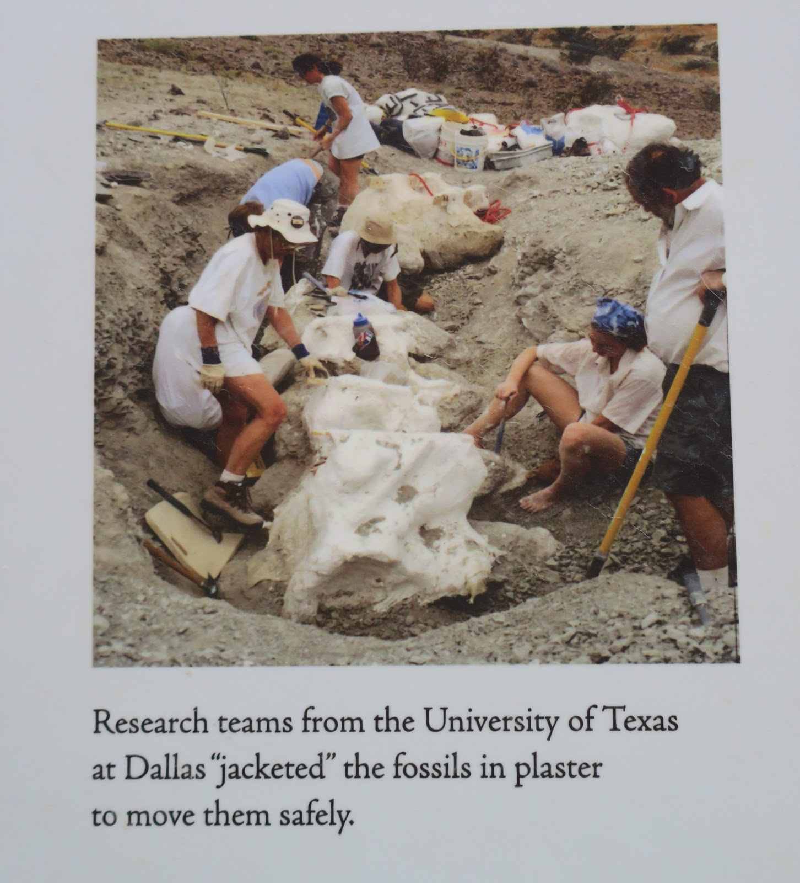
Objectives
Develop and refine radiometric dating techniques to achieve higher precision and accuracy in age determinations for fossil specimens across different geological contexts and time scales
Conduct targeted dating studies of key fossil assemblages, stratigraphic intervals, and geological formations to elucidate the timing of major evolutionary events, environmental changes, and mass extinction events throughout Earth's history.

Slide 10
Advantages
Disadvantages
By establishing the chronological age of fossils, scientists can reconstruct the timeline of evolutionary events, including the emergence of species, their diversification, and extinction patterns
Fossil dating provides crucial insights into the geological history of Earth, allowing researchers to correlate fossil assemblages with specific periods in time and understand past environmental conditions
Fossil specimens suitable for dating may be rare or difficult to access, restricting the scope of research and leading to incomplete understanding of evolutionary timelines.
Certain dating techniques require the destruction of fossil specimens, limiting further analysis or future research opportunities on the same sample.

Slide 11
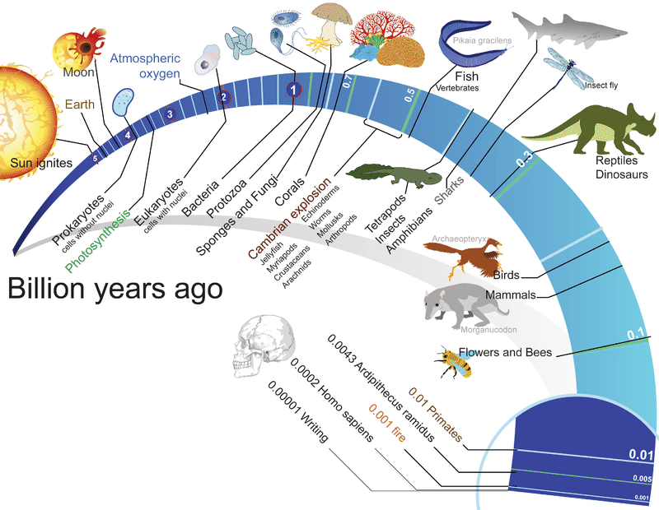
Evolution of living beings

Slide 12
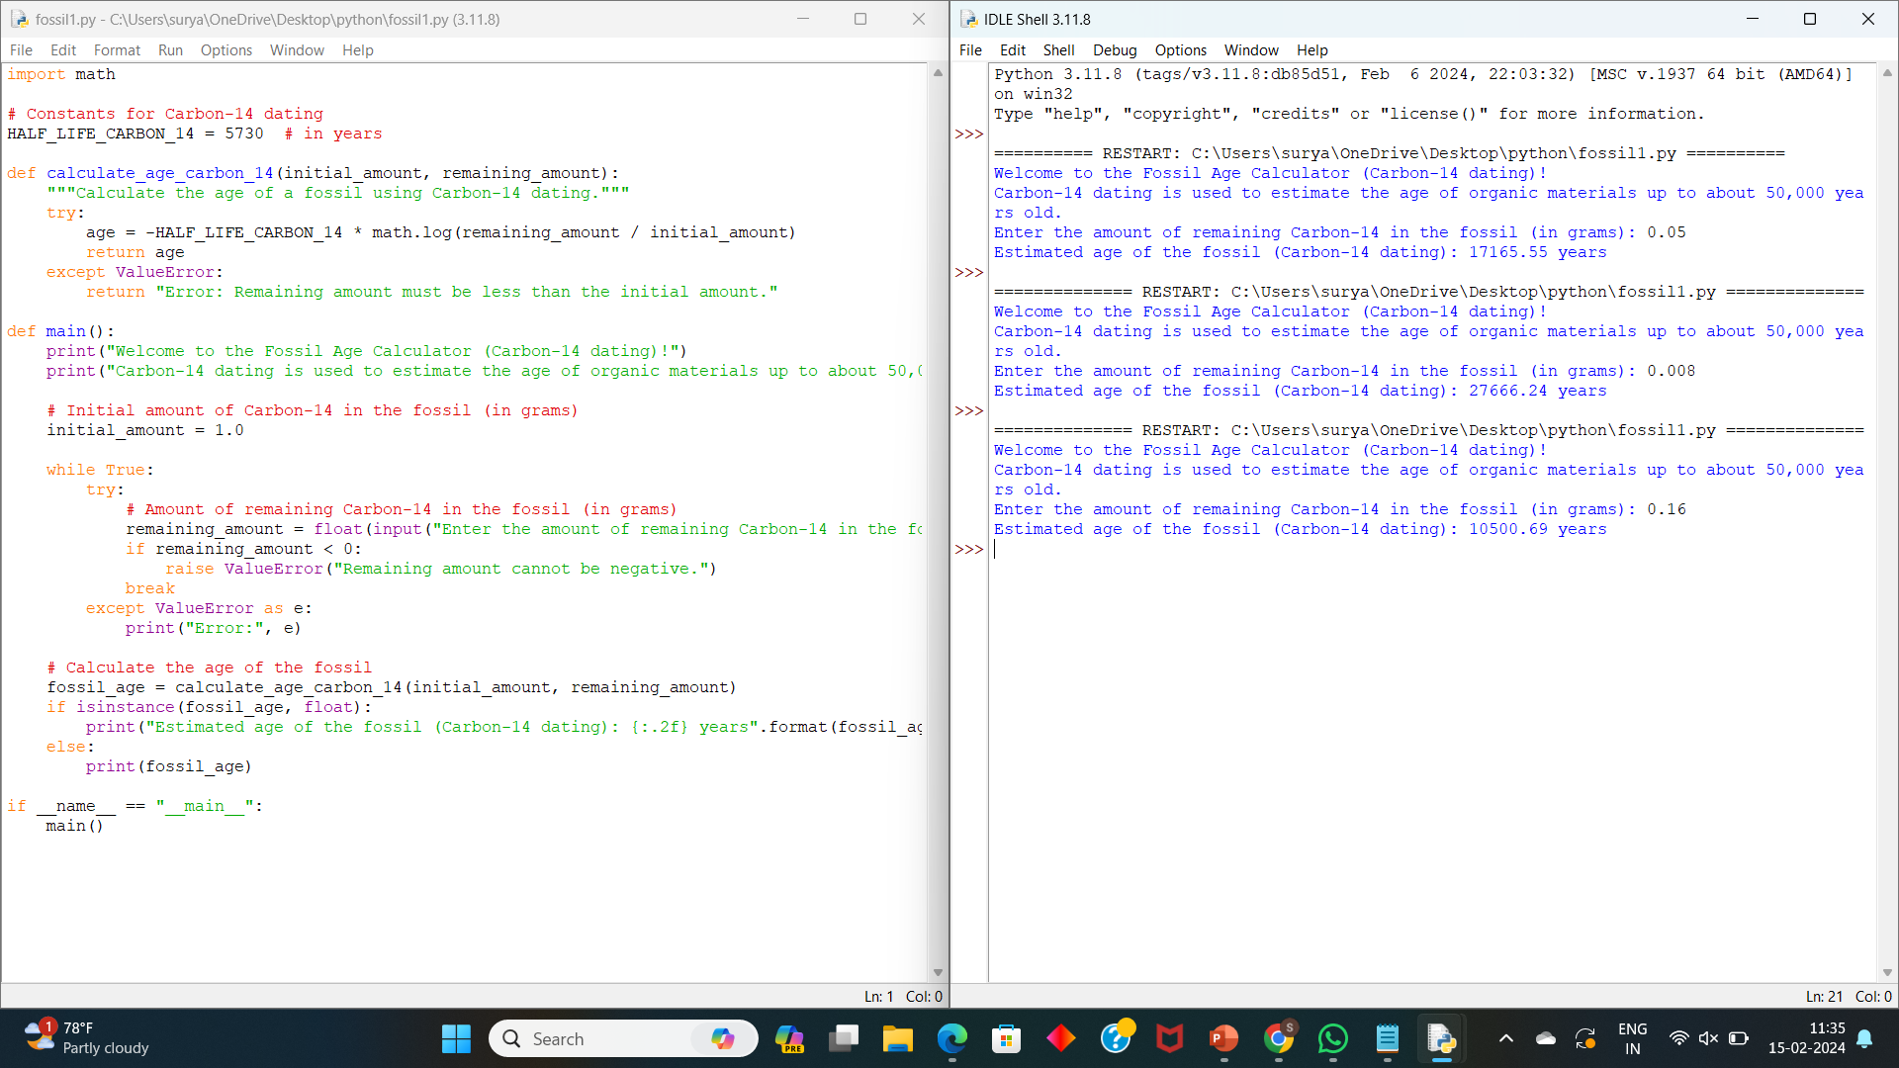
Program

Slide 13
Code Explanation
Importing module: import math (provides mathematical functions like logarithms.)
Constants:HALF_LIFE_CARBON_14 = 5730
Function : def calculate_age_carbon_14(initial amount, remaining amount)
Main Function : def main():
Prompts the user to input the remaining amount of Carbon-14 in the fossil.
Calls the ‘calculate_age_carbon_14’ function to estimate the age of fossil
Execution Block : if __name__ == "__main__":
main()
The ‘main’ function is executed only when the script is run directly.

Slide 14
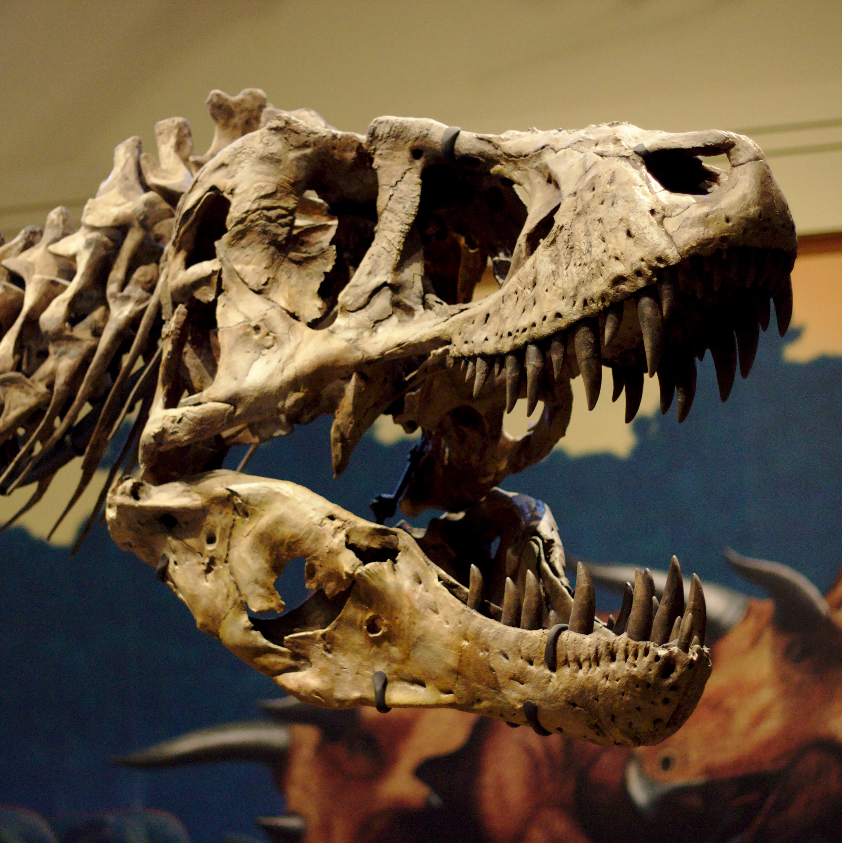
Conclusion
In the quest to unravel the mysteries of Earth's ancient past, determining the chronological age of fossils stands as a fundamental endeavor, bridging the realms of paleontology, geochronology, and earth sciences
Through the integration of diverse dating techniques, interdisciplinary collaborations, and advancements in analytical technologies, scientists continue to push the boundaries of our understanding, peering back through the corridors of time to reconstruct the evolutionary tapestry of life on our planet

